Slide 1



T20 DASHBORD IN POWER BI
View in Power BI
Last data refresh:
6/3/2024 5:45:10 AM UTC
Downloaded at:
6/3/2024 5:46:08 AM UTC

Slide 2
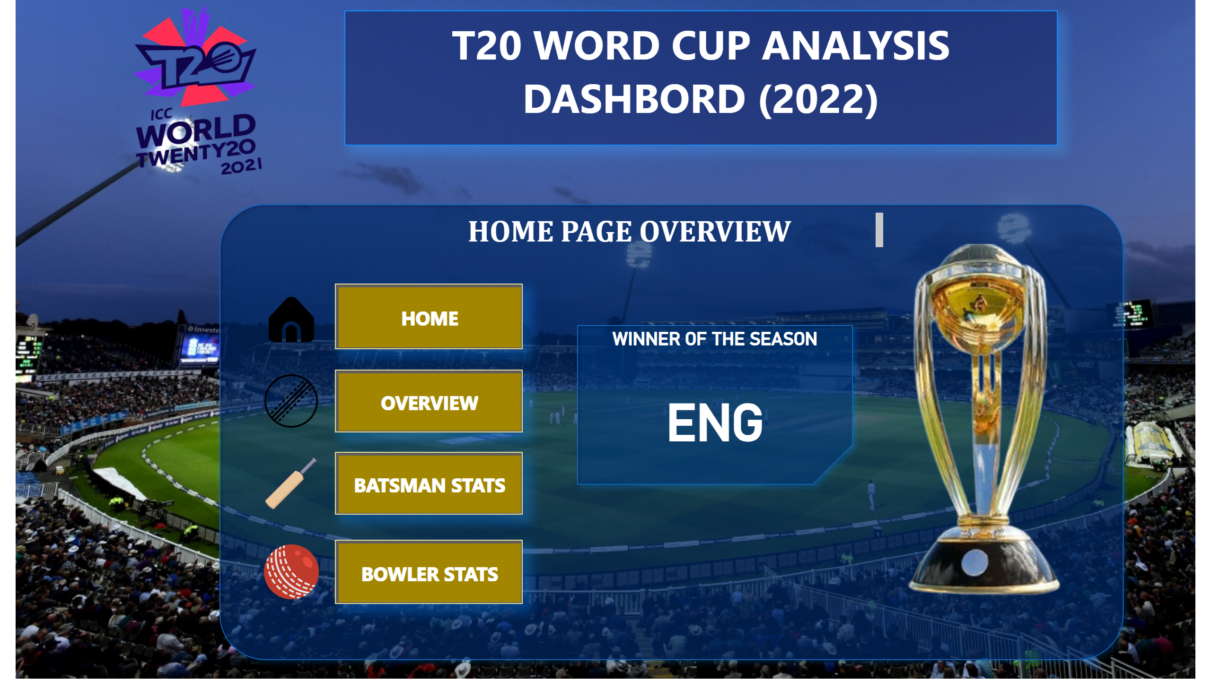
HOME PAGE
Notes:
textbox
No alt text provided
image
No alt text provided
shape
No alt text provided
textbox
No alt text provided
actionButton
No alt text provided
actionButton
No alt text provided
actionButton
No alt text provided
actionButton
No alt text provided
image
No alt text provided
image
No alt text provided
image
No alt text provided
image
No alt text provided
image
No alt text provided
shape
No alt text provided
WINNER OF THE SEASON
No alt text provided

Slide 3
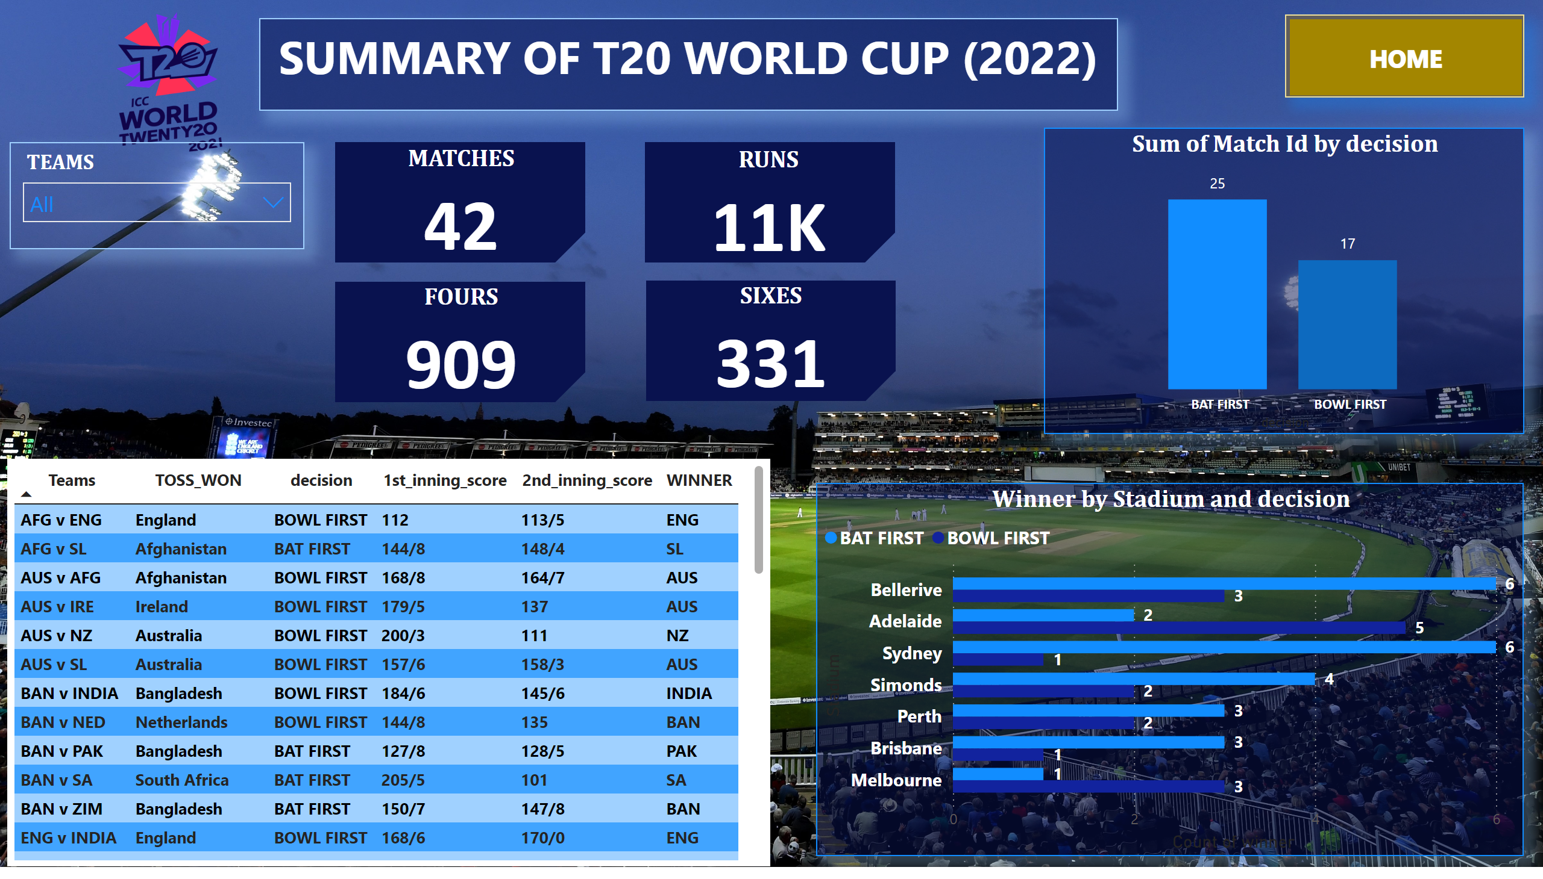
OVERVIEW
Notes:
textbox
No alt text provided
image
No alt text provided
actionButton
No alt text provided
slicer
No alt text provided
tableEx
No alt text provided
Winner by Stadium and decision
No alt text provided
columnChart
No alt text provided
shape
No alt text provided
shape
No alt text provided
shape
No alt text provided
shape
No alt text provided
MATCHES
No alt text provided
RUNS
No alt text provided
SIXES
No alt text provided
FOURS
No alt text provided

Slide 4
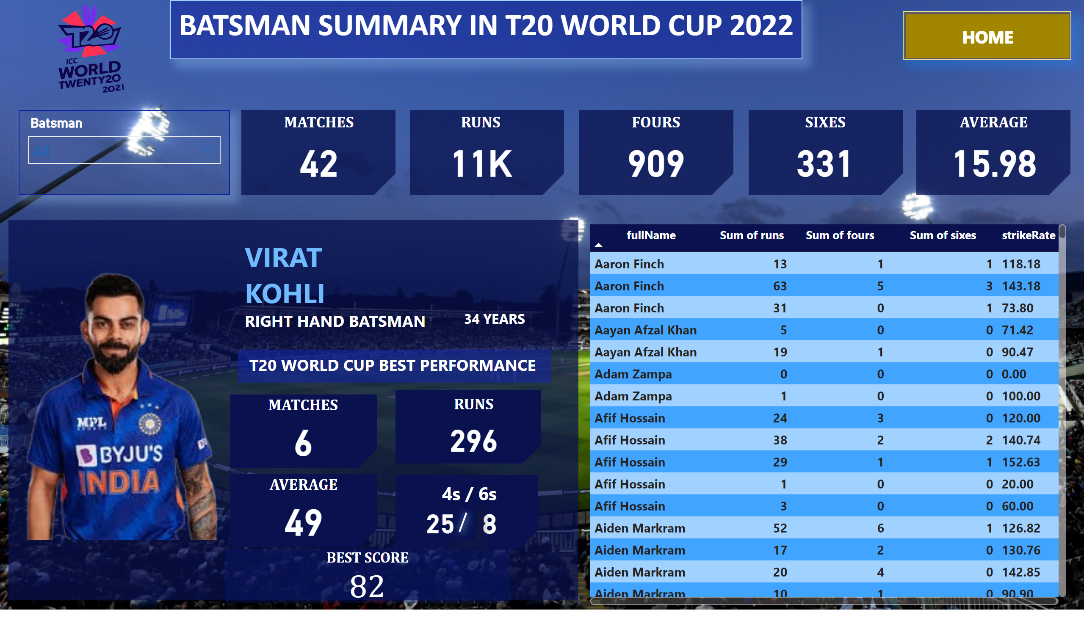
BATSMAN STATS
Notes:
textbox
No alt text provided
image
No alt text provided
actionButton
No alt text provided
slicer
No alt text provided
shape
No alt text provided
shape
No alt text provided
shape
No alt text provided
shape
No alt text provided
shape
No alt text provided
MATCHES
No alt text provided
RUNS
No alt text provided
FOURS
No alt text provided
SIXES
No alt text provided
AVERAGE
No alt text provided
tableEx
No alt text provided
shape
No alt text provided
image
No alt text provided
textbox
No alt text provided
textbox
No alt text provided
textbox
No alt text provided
shape
No alt text provided
shape
No alt text provided
shape
No alt text provided
shape
No alt text provided
MATCHES
No alt text provided
RUNS
No alt text provided
AVERAGE
No alt text provided
textbox
No alt text provided
AVERAGE
No alt text provided
AVERAGE
No alt text provided
shape
No alt text provided
BEST SCORE
No alt text provided

Slide 5
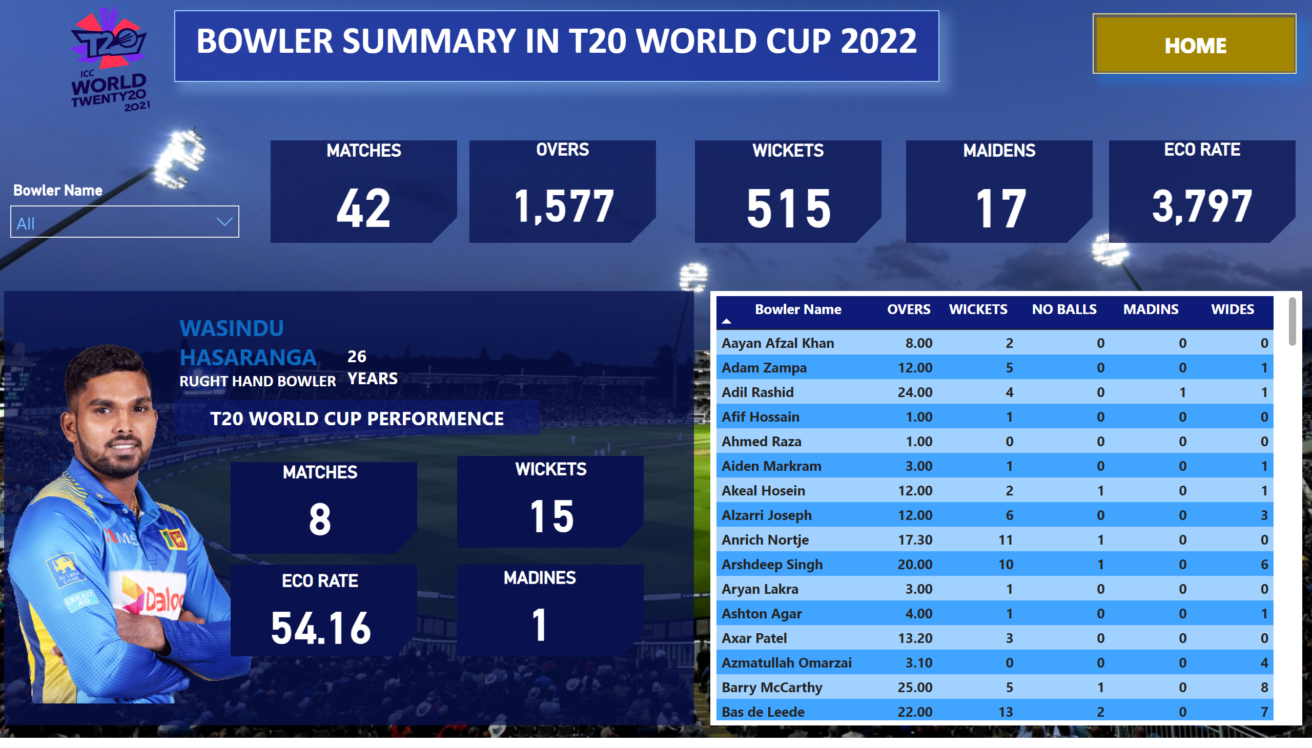
BOWLER STATS
Notes:
textbox
No alt text provided
image
No alt text provided
actionButton
No alt text provided
slicer
No alt text provided
shape
No alt text provided
shape
No alt text provided
shape
No alt text provided
shape
No alt text provided
shape
No alt text provided
MATCHES
No alt text provided
OVERS
No alt text provided
WICKETS
No alt text provided
MAIDENS
No alt text provided
ECO RATE
No alt text provided
tableEx
No alt text provided
shape
No alt text provided
image
No alt text provided
textbox
No alt text provided
textbox
No alt text provided
textbox
No alt text provided
MATCHES
No alt text provided
shape
No alt text provided
shape
No alt text provided
shape
No alt text provided
shape
No alt text provided
WICKETS
No alt text provided
ECO RATE
No alt text provided
MADINES
No alt text provided

